Slide 1
SOS Crash Alert Hackathon 2017
Realize innovation.
Restricted © Siemens AG 2017

Slide 2
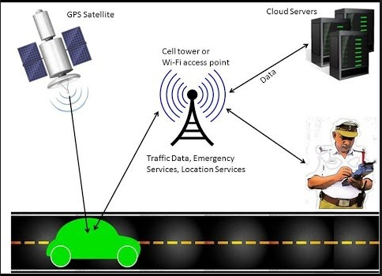
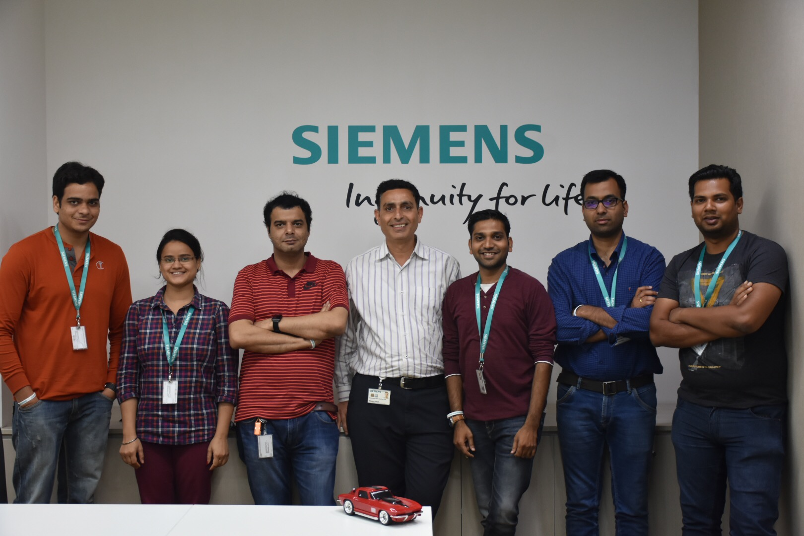
SOS Crash Alert Team
Team Photo
Presentation and Concept – Makarand Khekale
Mobile App – Ashish Modi & Mohneesh Damade
Micro-Services – Amit Karir & Kanika Kapoor
Web DashBoard – Arunesh Dubey & Akhilesh Verma

Slide 3
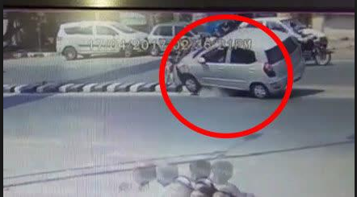
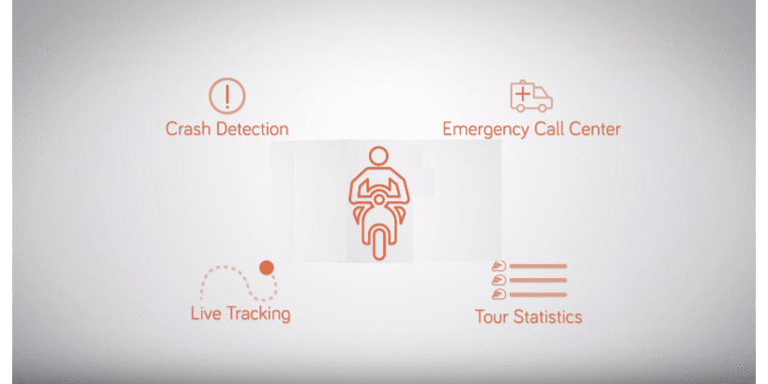
SOS Crash Alert Problem Statement
Road Accident due to bad road design or other reasons
Helping people don’t have nearby Ambulance, Police, Crane contact numbers
Time loss to escort injured person to hospital
Time loss in legal formalities/police process
No timely finance/insurance/medi-claim availability
Blood group shortage
Injured person may loose the life

Slide 4
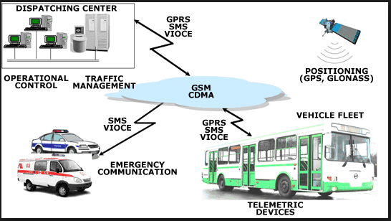
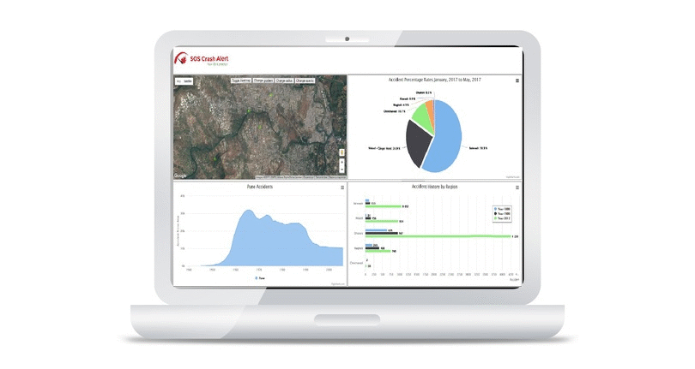
SOS Crash Alert Concept

Slide 5


SOS Crash Alert Features
http://soscrashalert.cfapps.io/soscrashalert/main.html
Web Dashboard to show Accident prone areas
Web Live Report to all stake holders
Mobile Sensor detector and alert generation
Mobile App with Acknowledgement Facility
Show accident spot on Google map
Show distance of emergency services

Slide 6
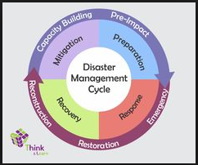




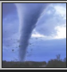
SOS Crash Alert Big Picture & Business Value
IoT Healthcare Solutions- Remote monitoring of
Patient’s health Statistics
Smart Grid Assess Monitoring
Agricultural Logistic Management For Emergency
Response
Disaster Management in Railways
Environment Disaster Tracking - wild fires,
tornadoes, earthquakes, cloudbursts and volcanic
Concept can be used in different business segments for Disaster Management
Provide services on MindSphere
Can provide Hardware-Software package offerings
Help to reduce financial and life losses

